Slide 1
Multifrequency Ultrasonic Treatment as a Liquid-State Processing Method of Aluminum Alloys
Raquel Fierro Jaime¹,
Andrew Zang^{1,2}, Adrianne Chang¹, Miodrag Prokic³, Martijn Vos⁴,
Carl Söderhjelm^{1,2}, Hélder Puga^{1,5}, Diran Apelian^{1,2}
¹University of California Irvine, ²Pratt & Whittney Center of Excellence,
³MPI Interconsulting, ⁴Aluminium Rheinfelden,
⁵CMEMS, University of Minho, Guimarães, Portugal

Slide 2
Outline
(3 min.)
(5 min.)
(8 min.)
(3 min.)
Total: 20 min.
Ultrasonic Treatment (UST) for Al Recycling
Liquid-State Multifrequency UST
Results
Conclusions

Slide 3
Outline
Ultrasonic Treatment (UST) for Al Recycling
Liquid-State Multifrequency UST
Results
Conclusions

Slide 4
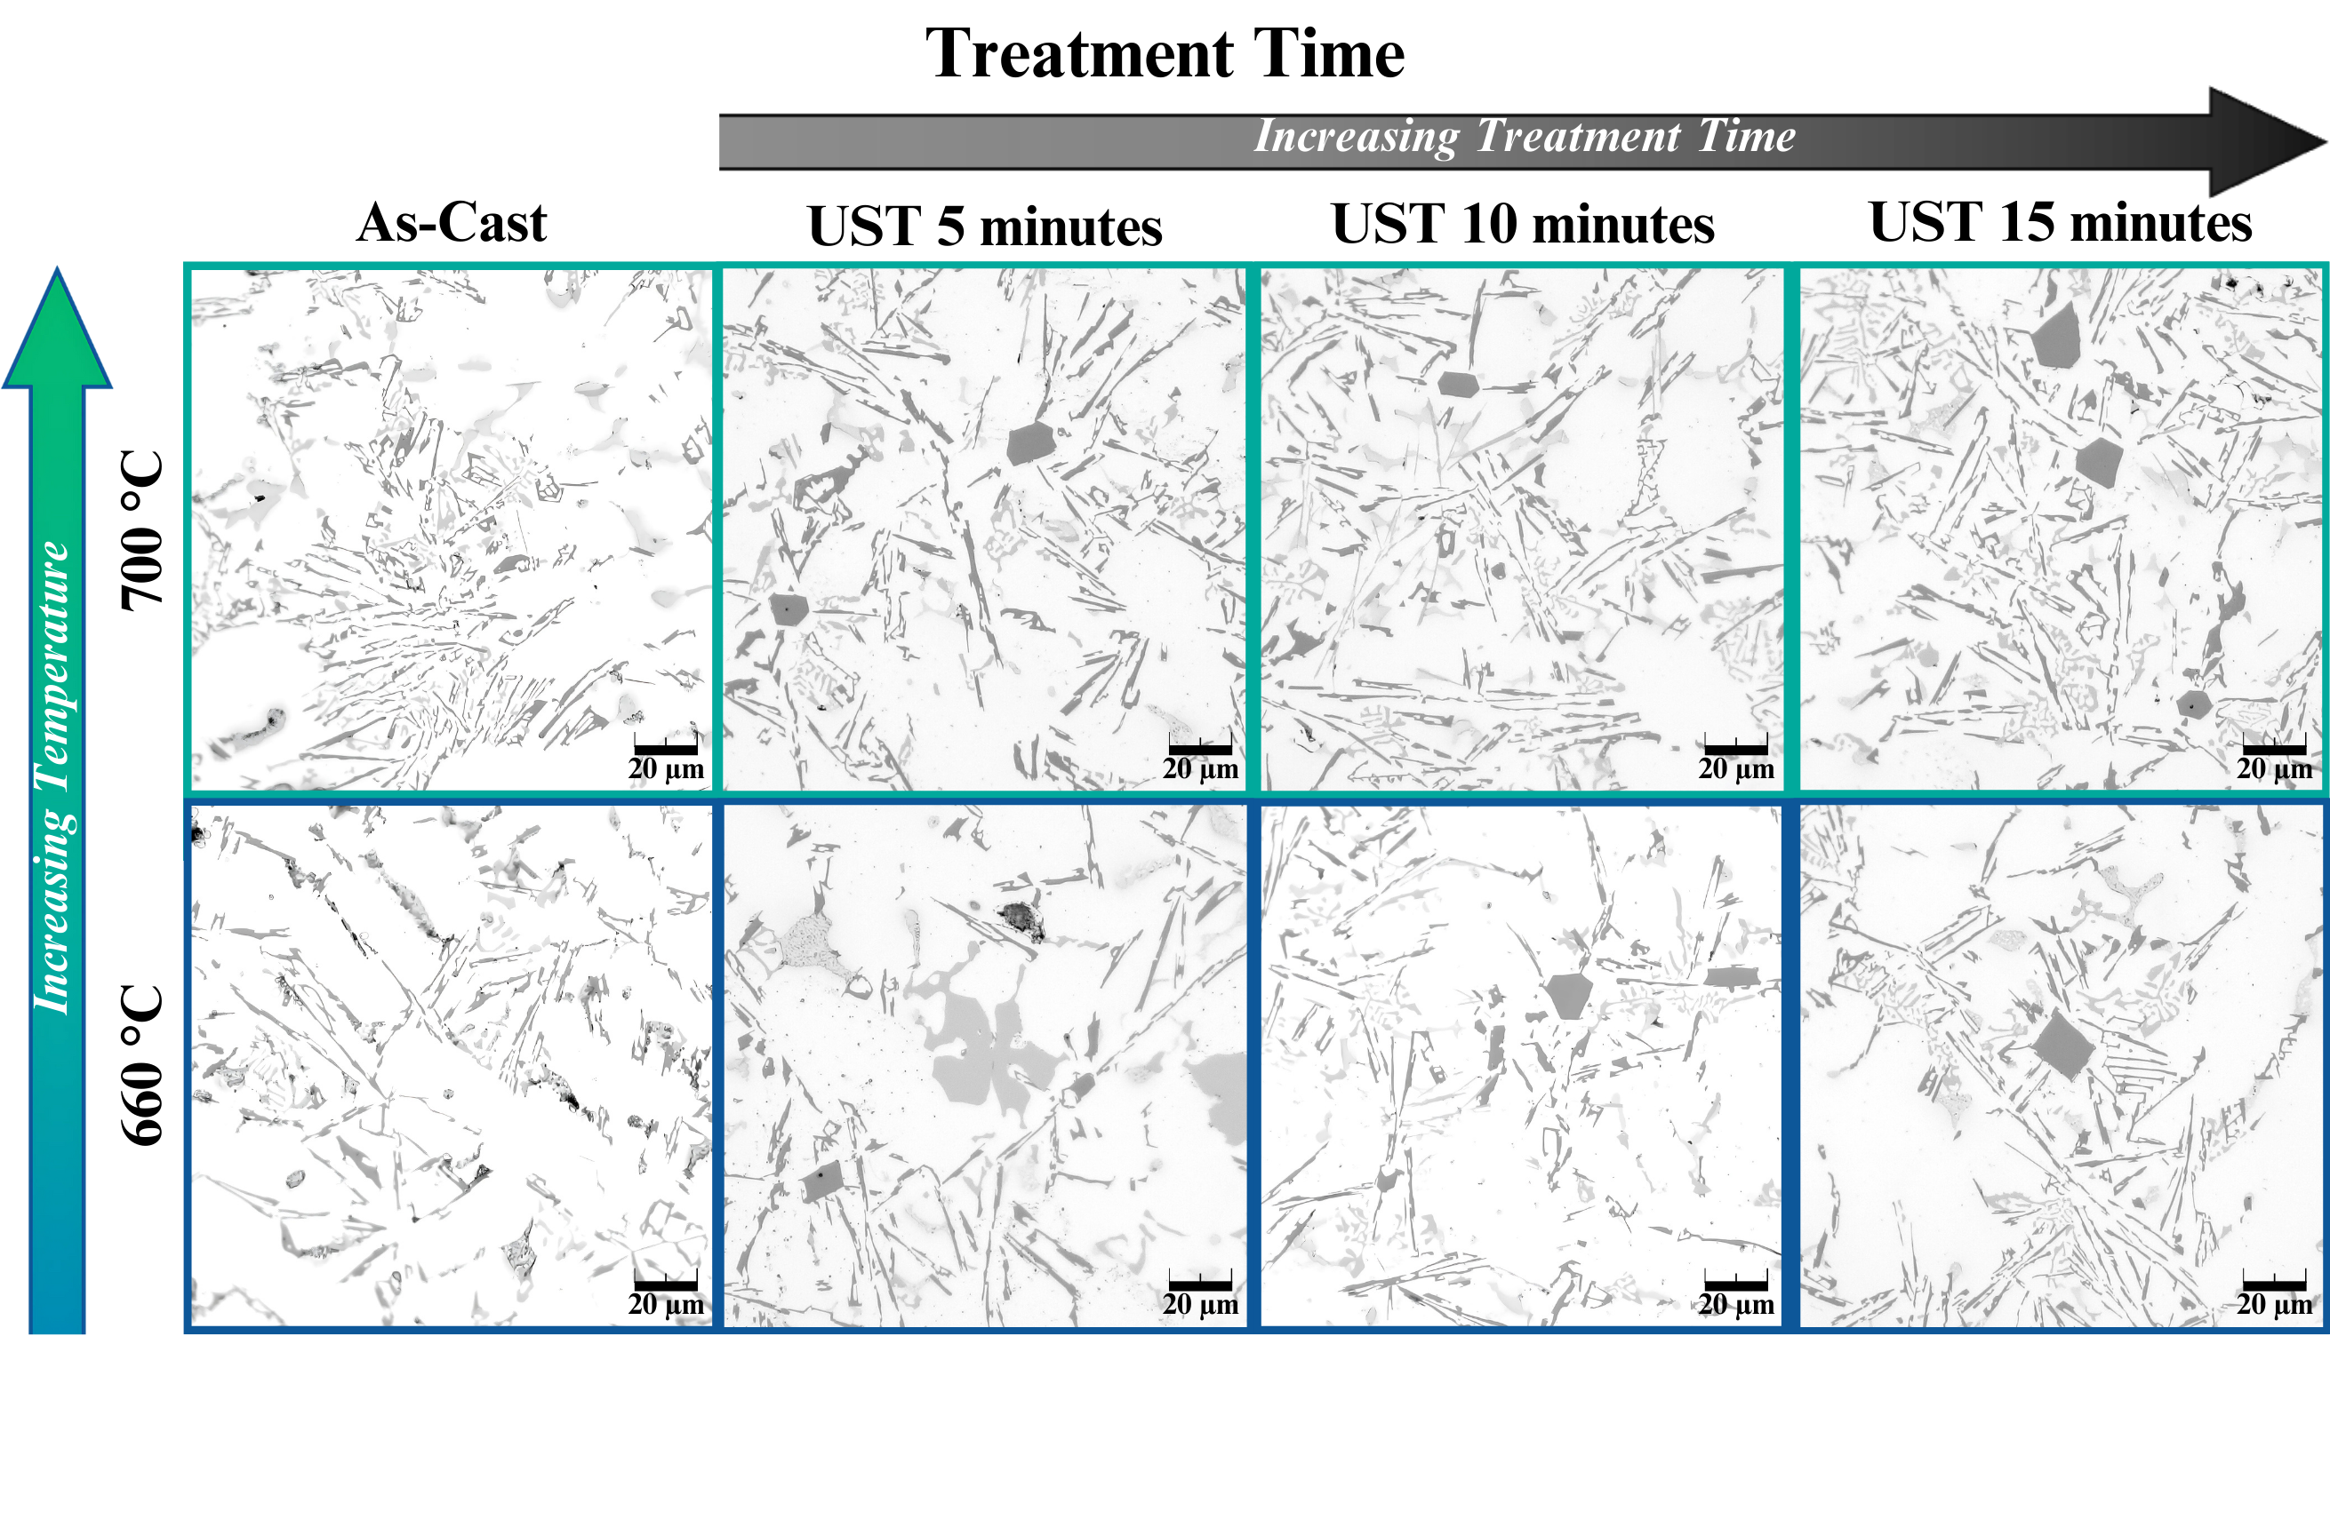
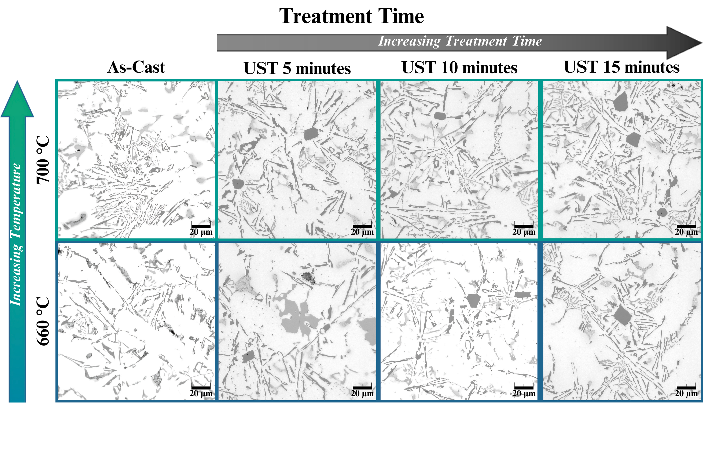


Recovery of Aluminum Alloys
Detrimental Intermetallics
Primary Aluminum
1.2 Billion Tons of CO₂
for 80,000 Tons of Al per year
β-Al₅FeSi
> 3.8 Million Tons
Secondary Aluminum per year
⍺-Al₁₅Fe₃Si₂
➞ post-consumer scrap available to recover
Liquid Metal
Processing
93% Reduction in CO₂
P. McKenna, et. al ICN 2023 S. Padamata, et. al JOM 2021

Slide 5

Liquid Metal Processing
Degassing
➞ ‘Metal Cleanliness’: Hydrogen & inclusion removal
Traditional methods: Rotary Degassing, Chemical Flux
Processing for Secondary Aluminum Recovery
Grain Refinement
➞ Tailor the microstructure via
grain size & intermetallic morphology
Traditionally: Chemical additives
Intermetallic Morphology
Modification
Ultrasonic Treatment (UST)
Sustainable approach
must be developed

Slide 6
Outline
Ultrasonic Treatment (UST) for Al Recycling
Liquid-State Multifrequency UST
Results
Conclusions

Slide 7
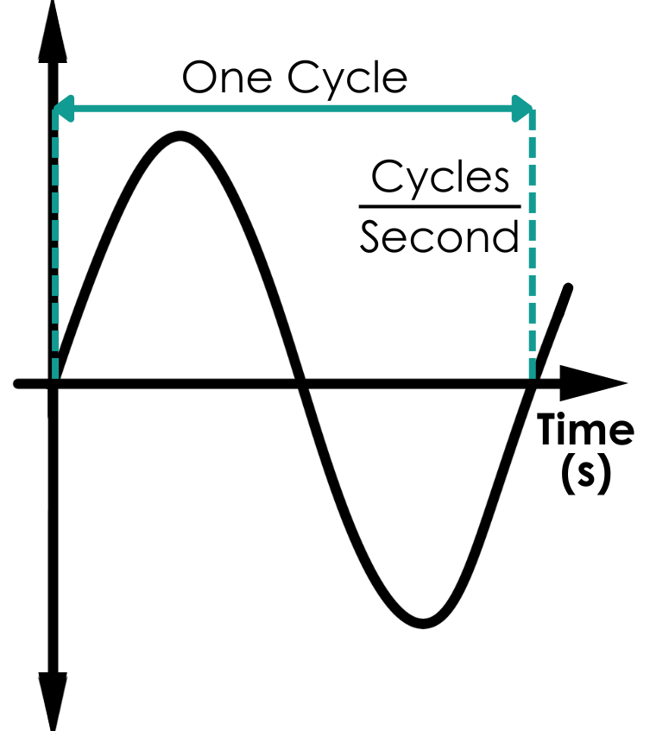
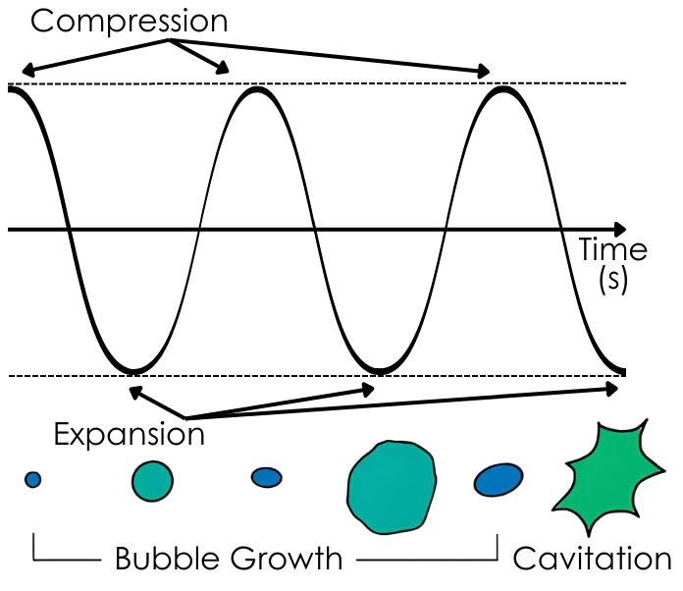
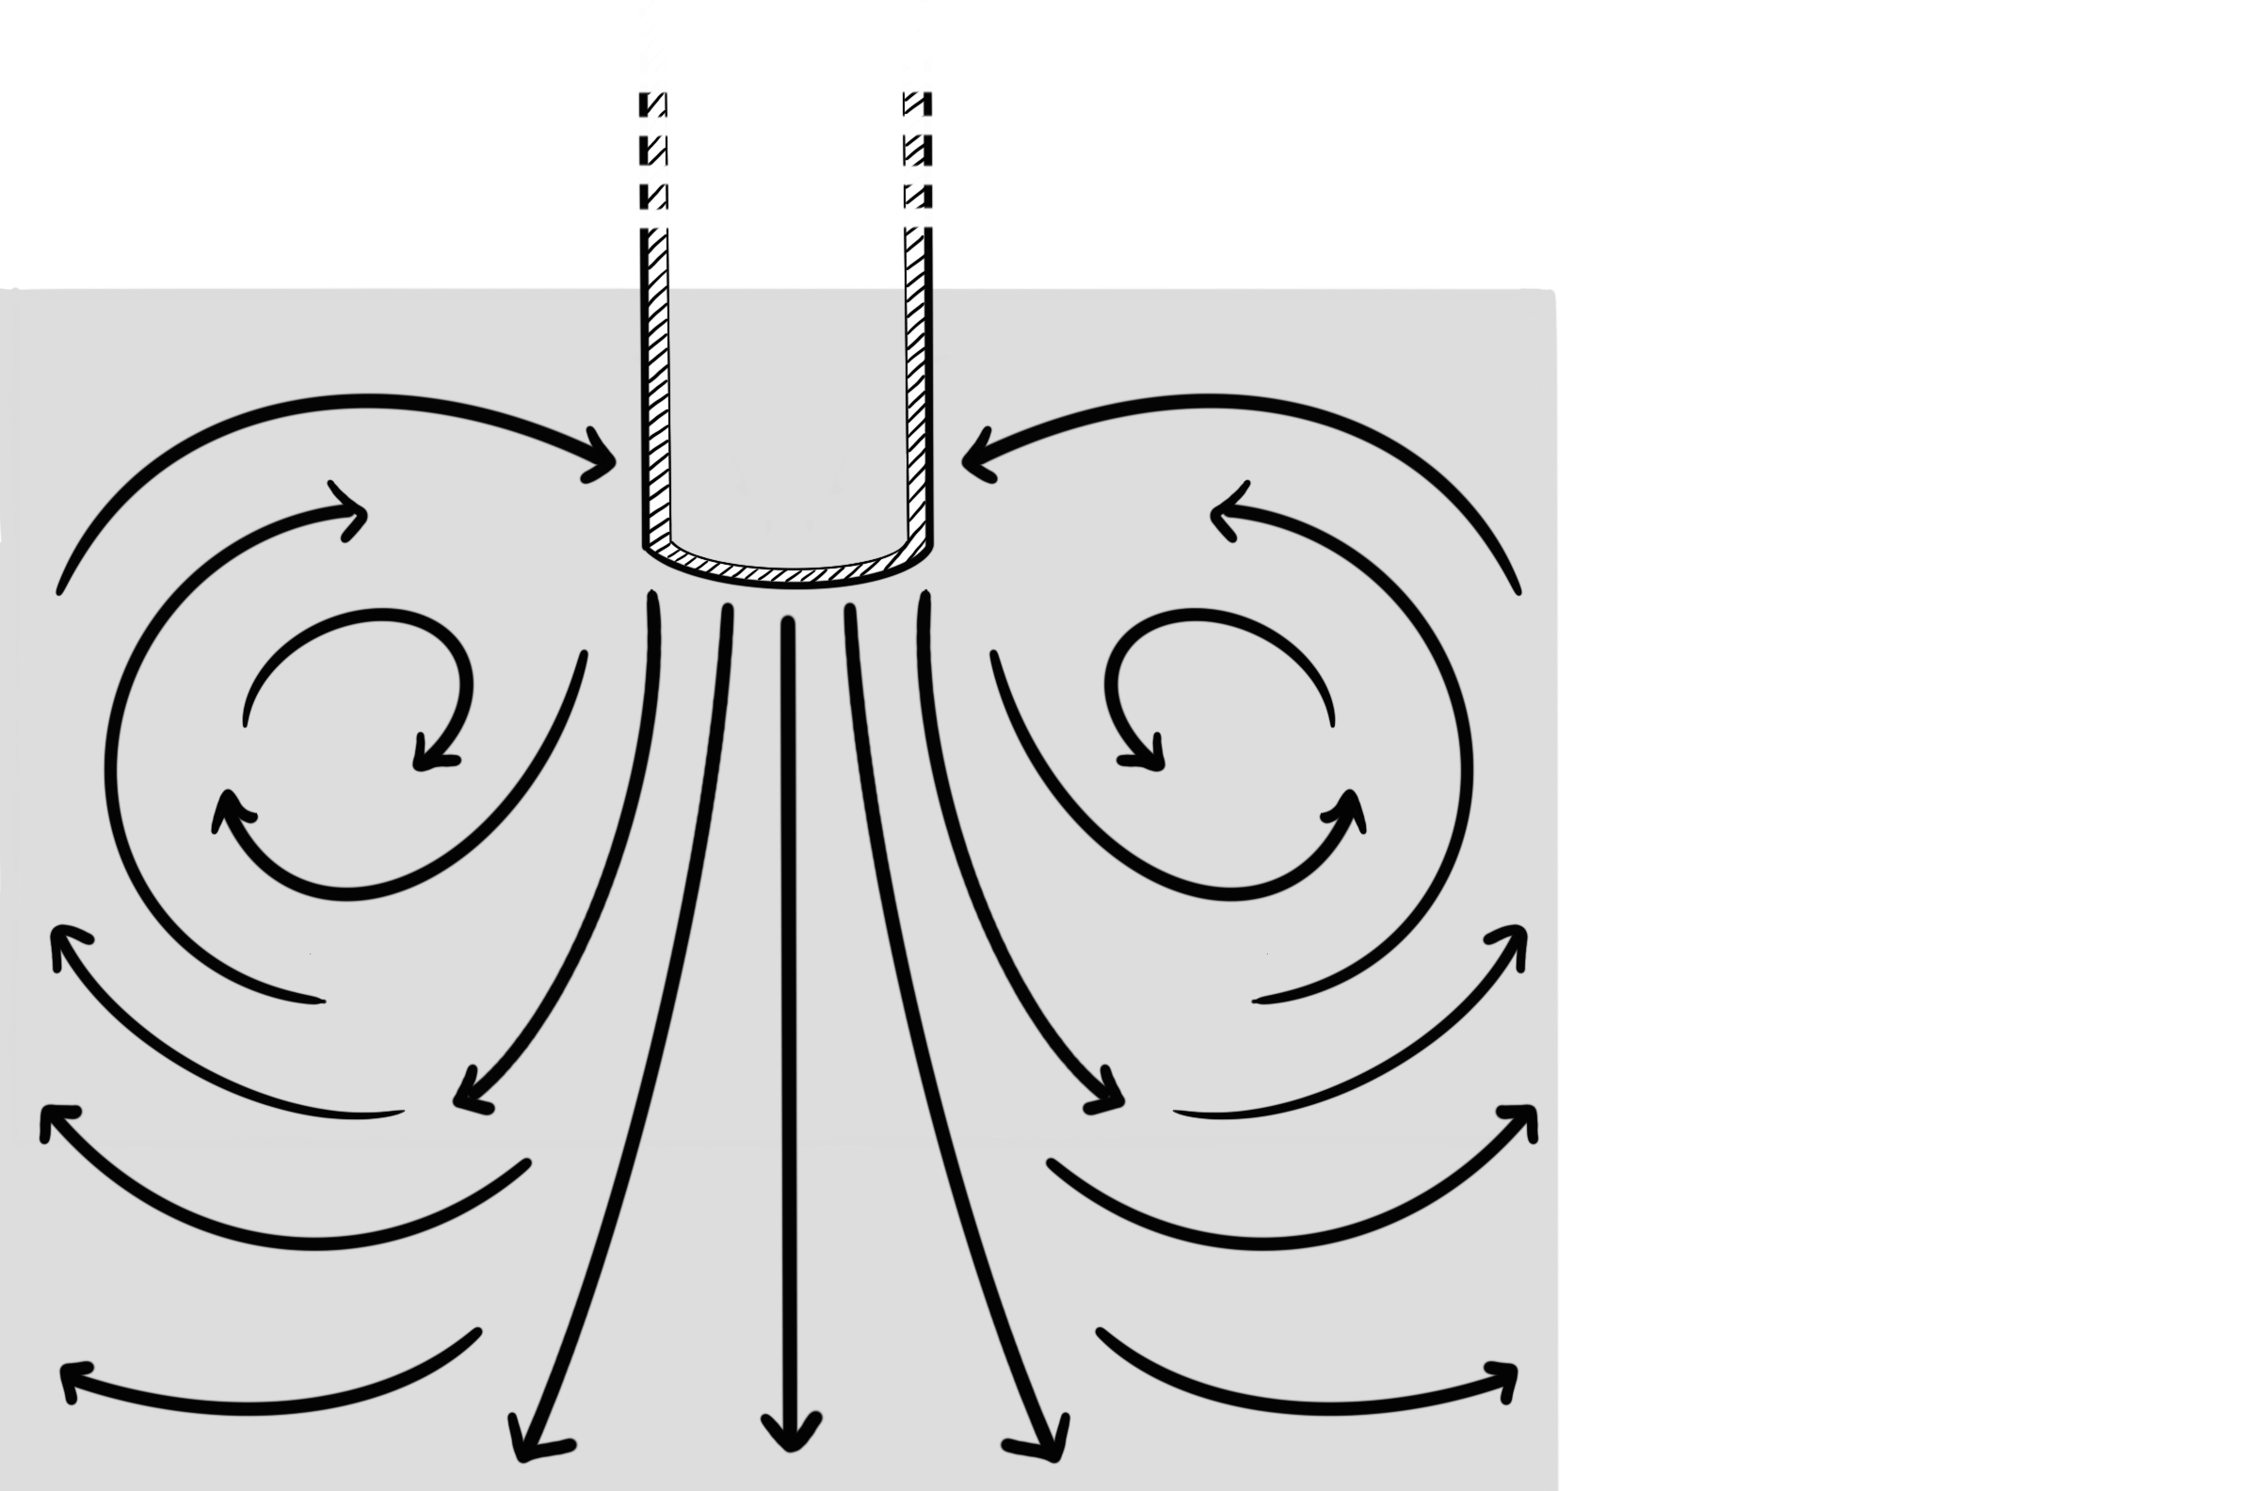
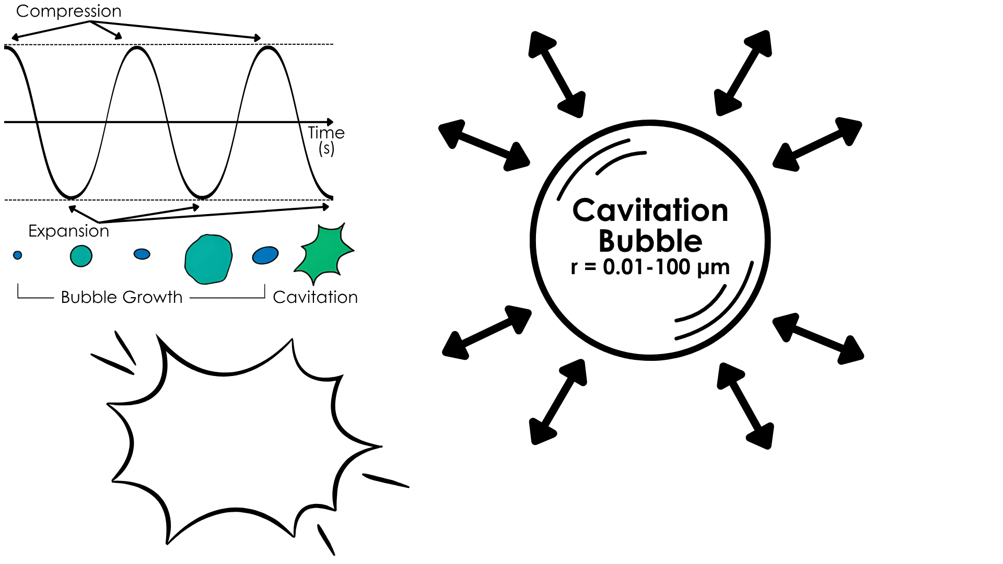

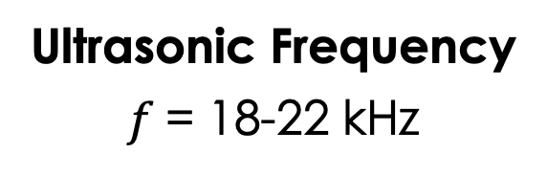
UST Processing of Molten Metal
Application of ultrasonic energy into molten metal
for microstructural modification
Acoustic Cavitation
Acoustic Streaming
$$f=$$
UST Probe
Liquid Metal
5000°C
5000m/s
Ultrasonic Frequency
$f$= 18-22 kHz
Expansion ~10 MPa
D. Eskin, et. al 2014

Slide 8
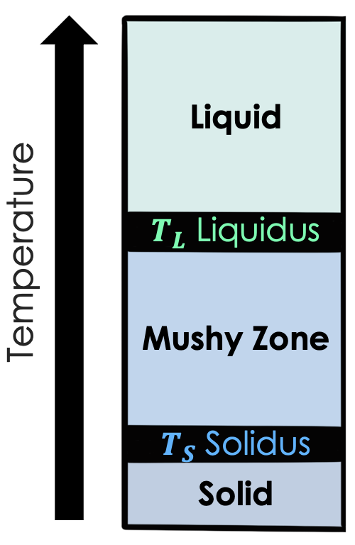
UST Processing of Molten Metal
Application of ultrasonic energy into molten metal
for microstructural modification
Acoustic Cavitation
Acoustic Streaming
Unproven
UST Probe
Liquid Metal
Grain Refinement &
Intermetallic Modification

Slide 9
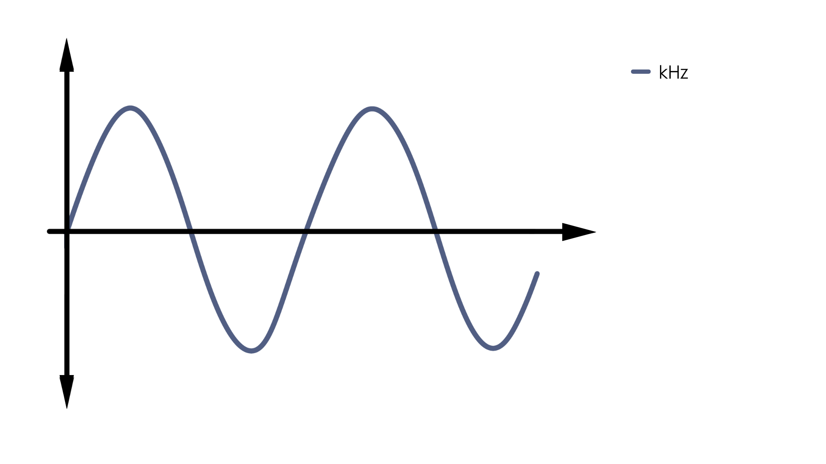
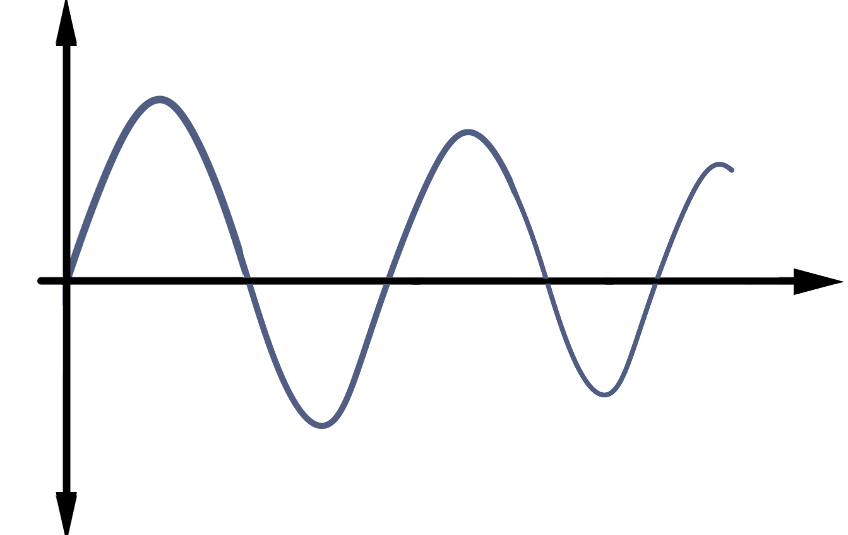
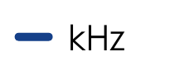
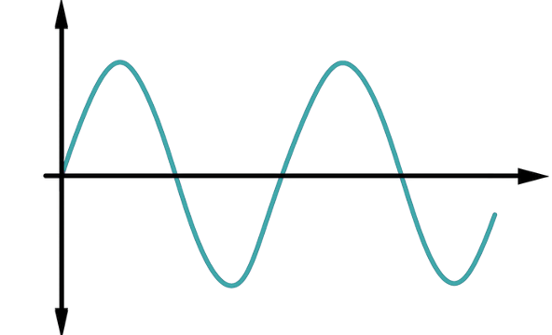
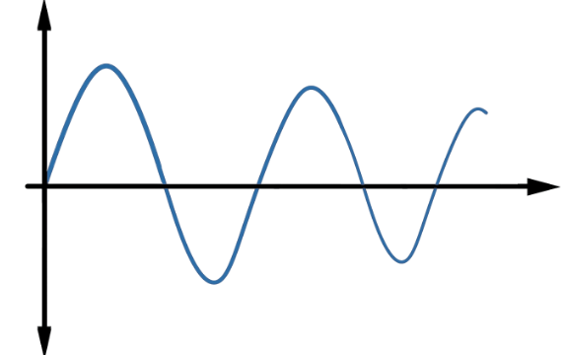
Frequency Delivery in UST Systems
Multifrequency Multimode Modulated (MMM)
Fixed Frequency
Source
Sensor
Most common in the field
Does not counteract decay
Gradient of treatment
Accounts for multiple
external frequencies
System Adaptive Processing

Slide 10
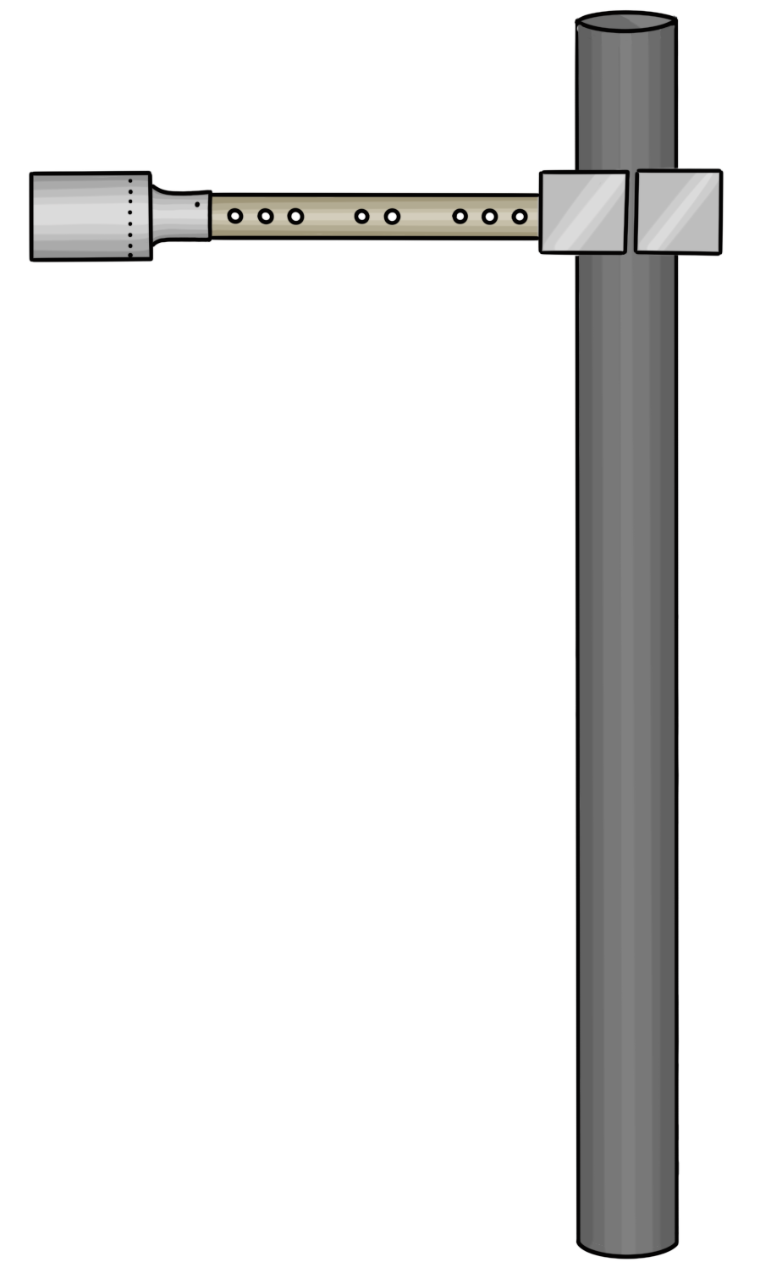
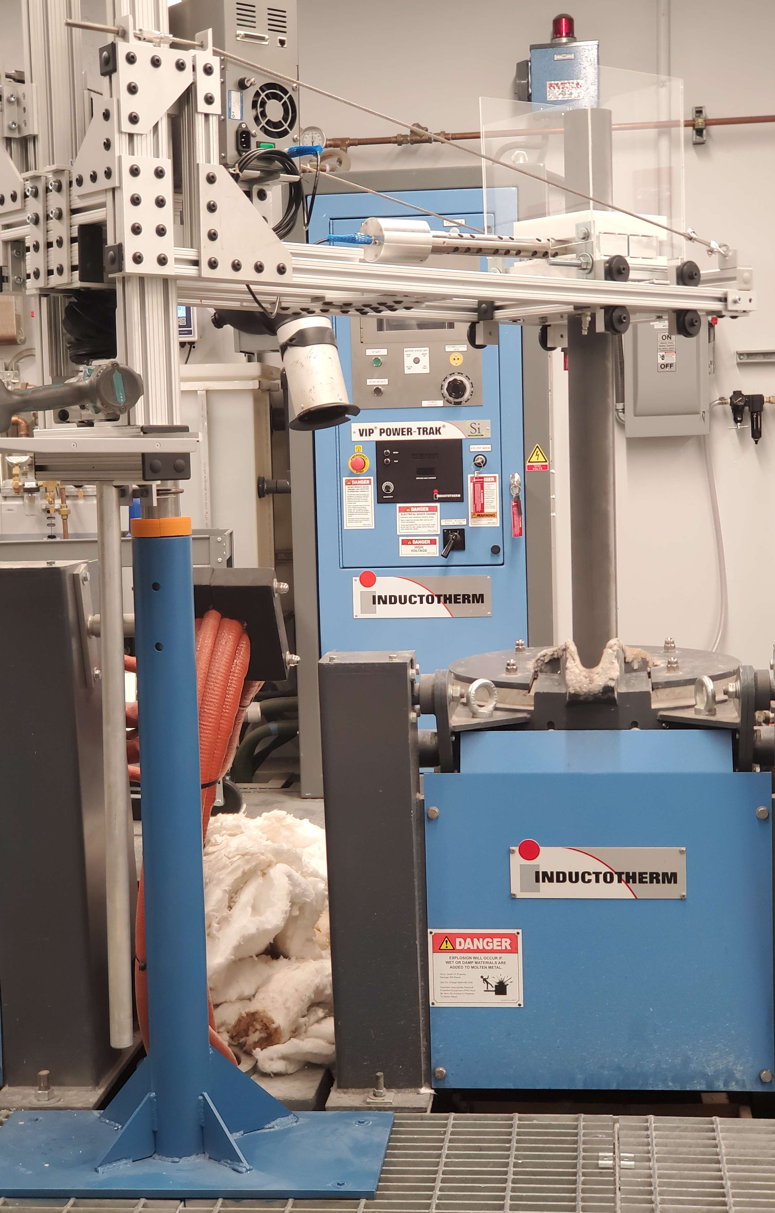

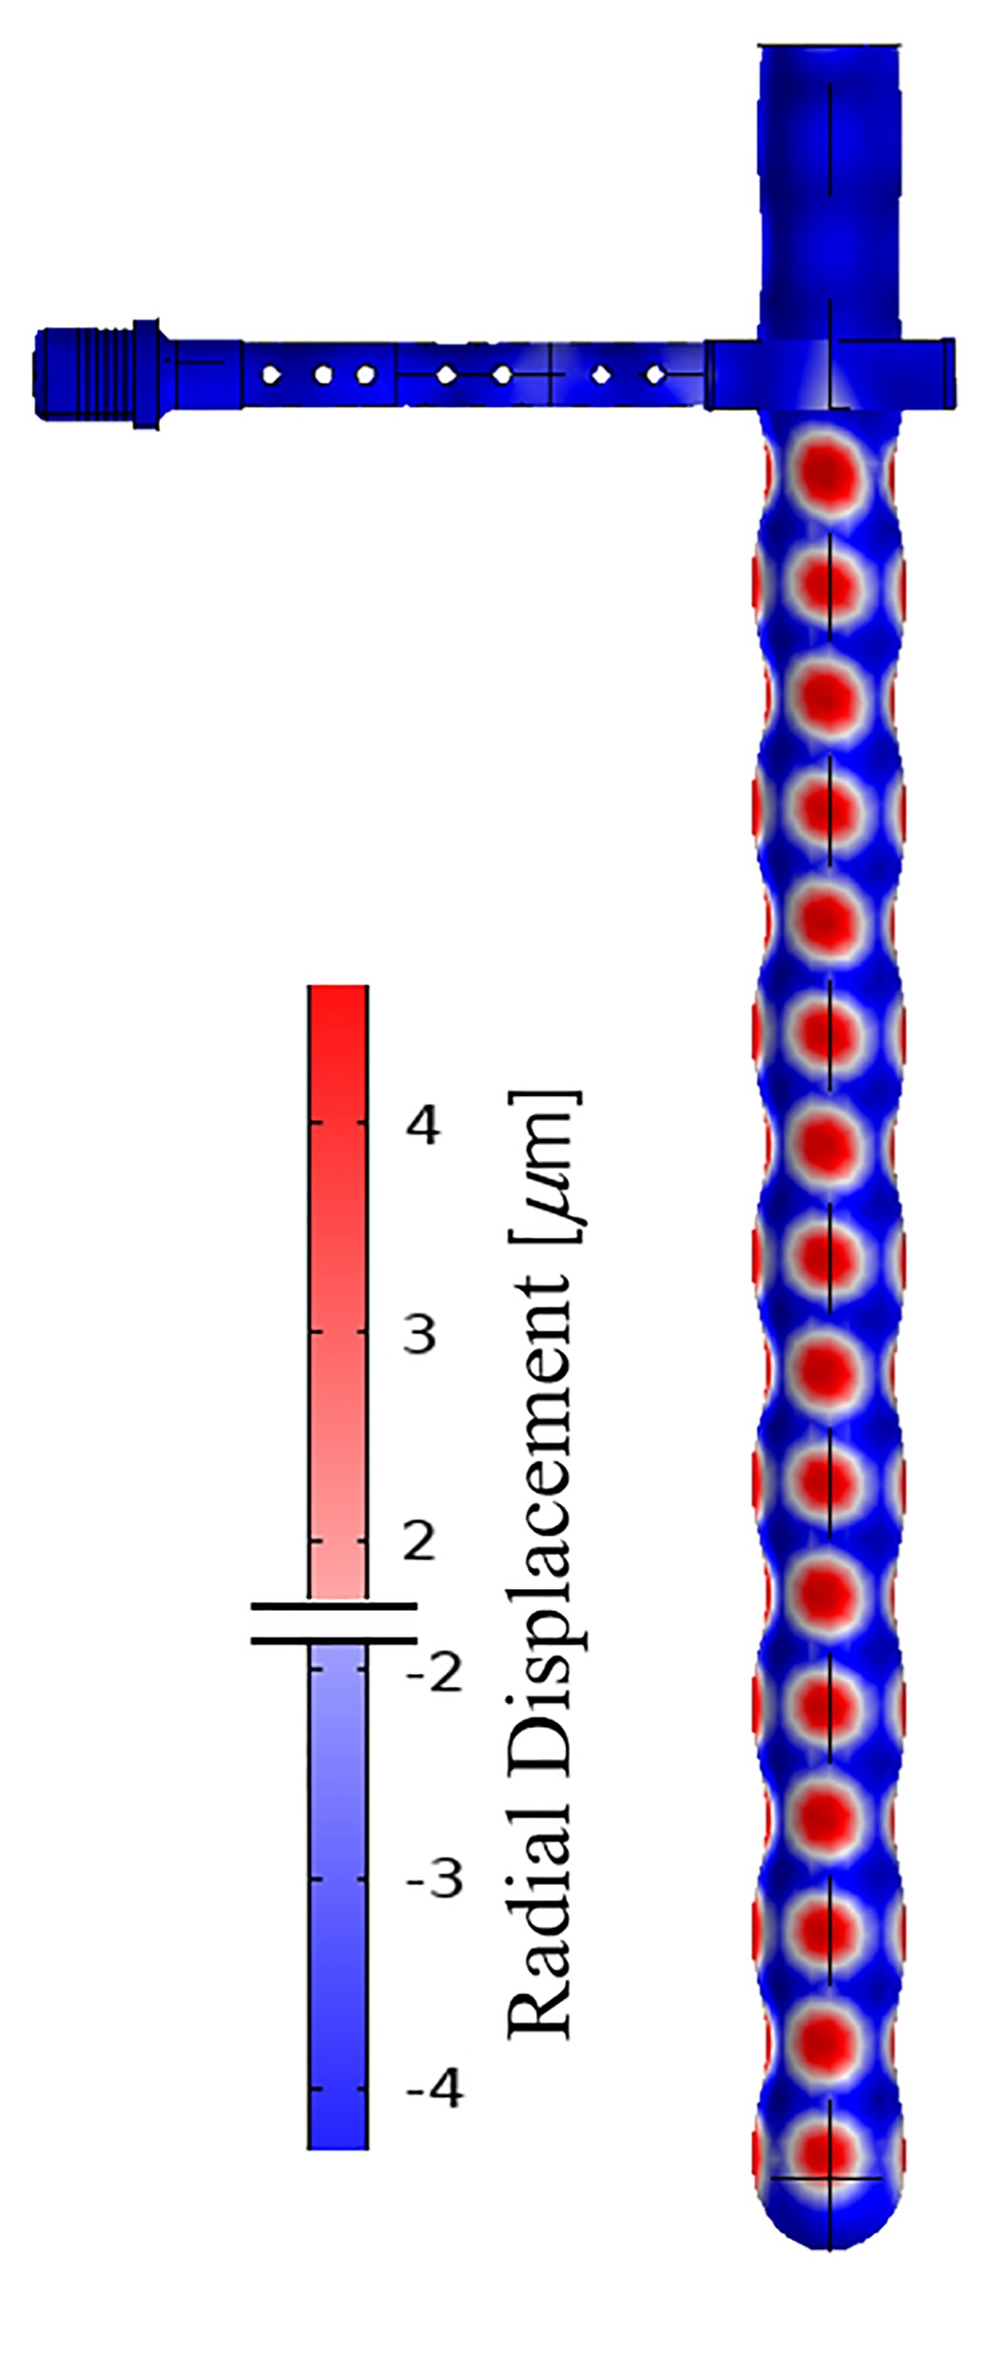



Multifrequency UST Experiments
Clamp
Treatment Temperature
720, 700, 680, 660 °C
Waveguide
PZT
Transducer
Treatment Time
5, 10, 15 minutes
Mass Treated
5, 10, 20 kilograms
Hollow
SiAlON Probe
Decay with Time
5, 10, 20 min. post-UST
Photo Courtesy H. Puga

Slide 11
Outline
Ultrasonic Treatment (UST) for Al Recycling
Liquid-State Multifrequency UST
Results
Conclusions

Slide 12
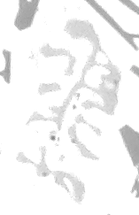
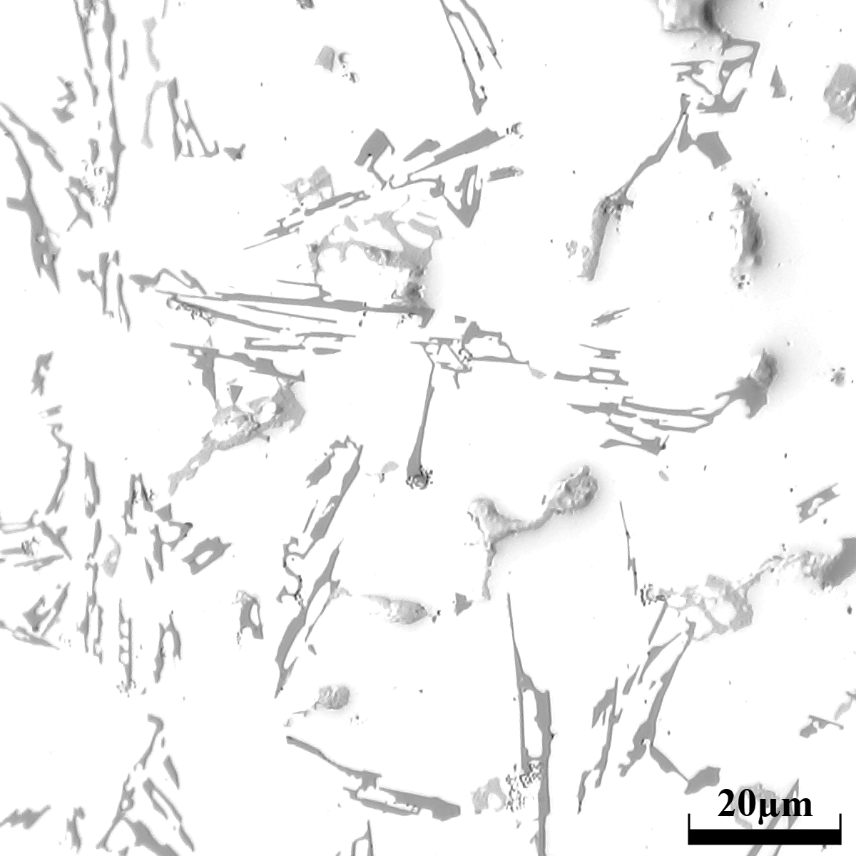
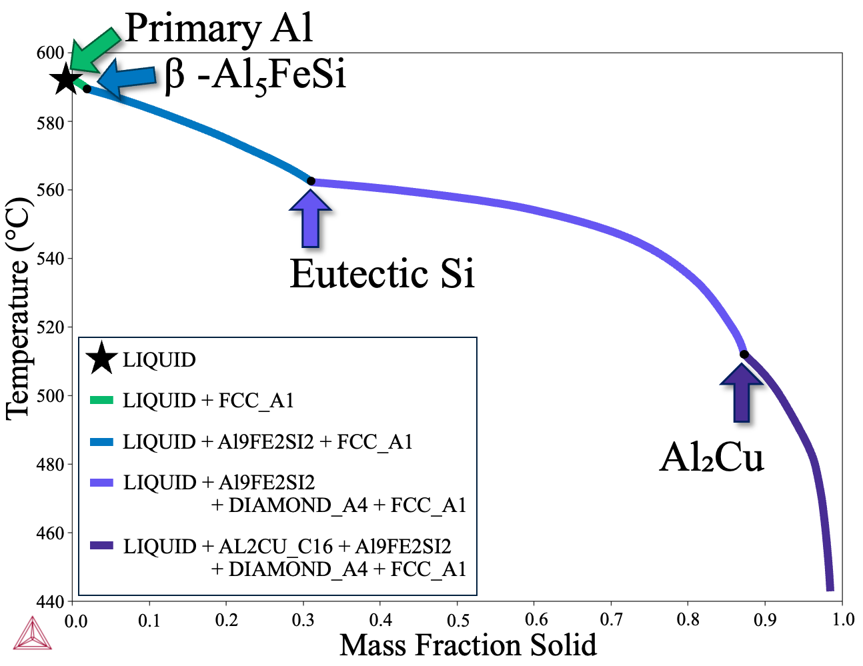
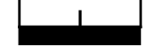
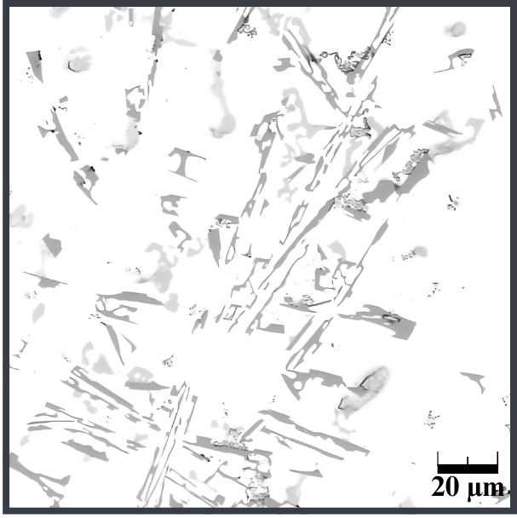
As-Cast Aluminum A380
A380 T_{L}=585°C
A380
 | wt. %
Si | 8.25
Cu | 3.53
Zn | 2.27
Fe | 0.845
Mn | 0.200
Cr | 0.070
P | 0.001
2
3
4
10 µm
⍺-Al₁₅Fe₂Si₃
Eutectic Si
Al₂Cu
1
Primary Al

Slide 13
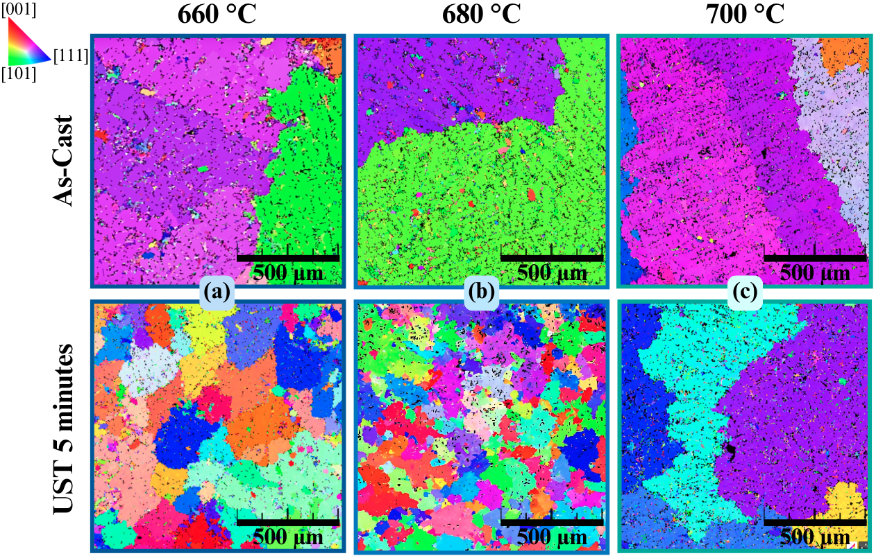
UST Grain Refinement of A380
Treatment Temperature
A380 T_{L}=585°C
What is the underlying mechanism of
UST Grain Refinement?
77% Decrease
86% Decrease
11% Decrease
Connection between Grain Size & Intermetallics

Slide 14
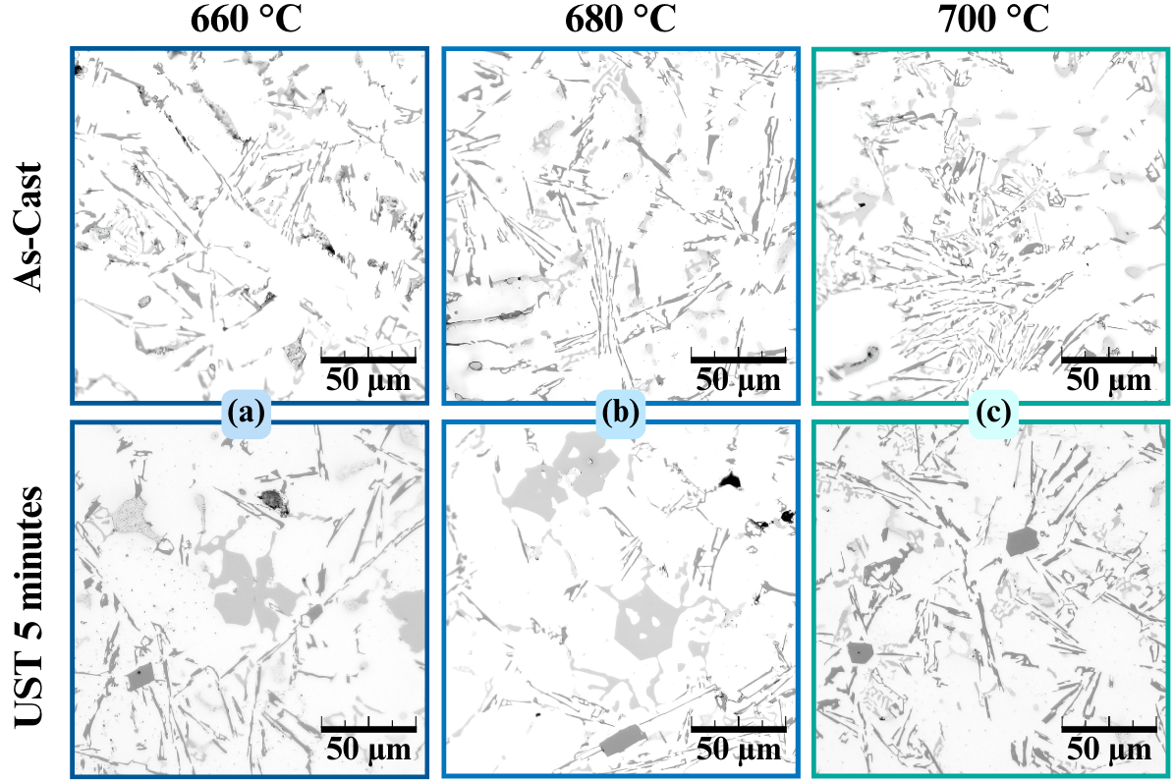
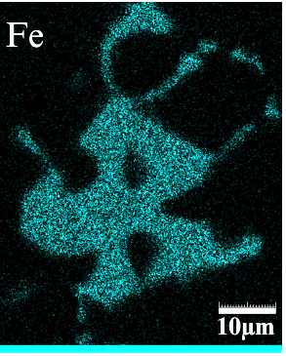
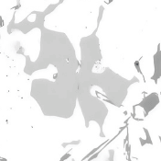
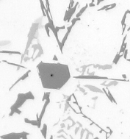
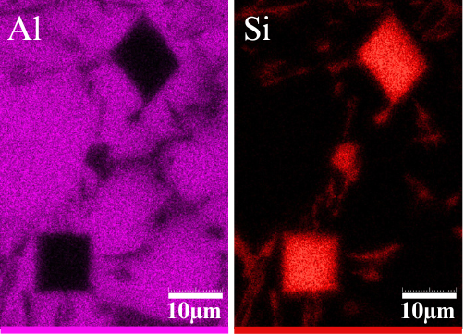
Intermetallic Modification
Treatment Temperature
A380 T_{L}=585°C
Polyhedral Fe
Fe-Phase only ≦ UST at 680°C
Si-Phase at all Temps
Primary Si

Slide 15
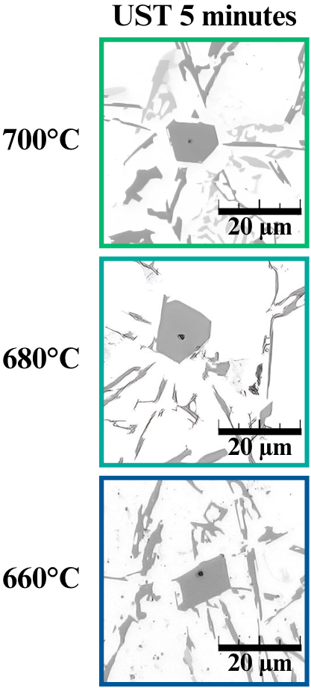
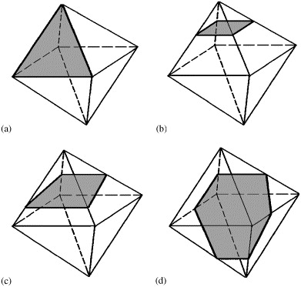
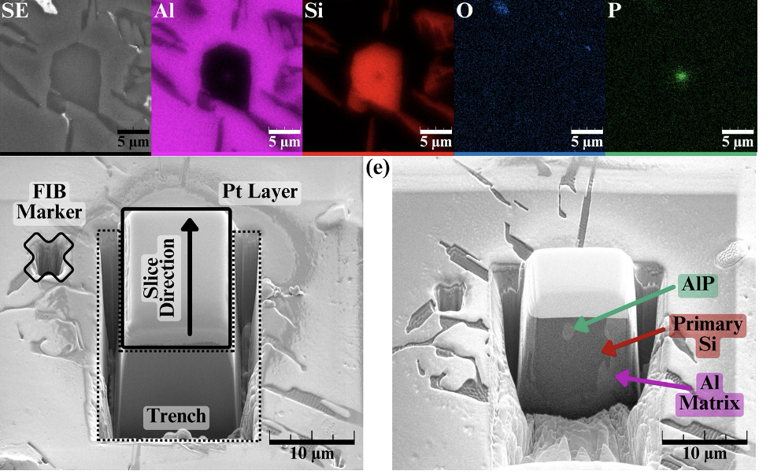
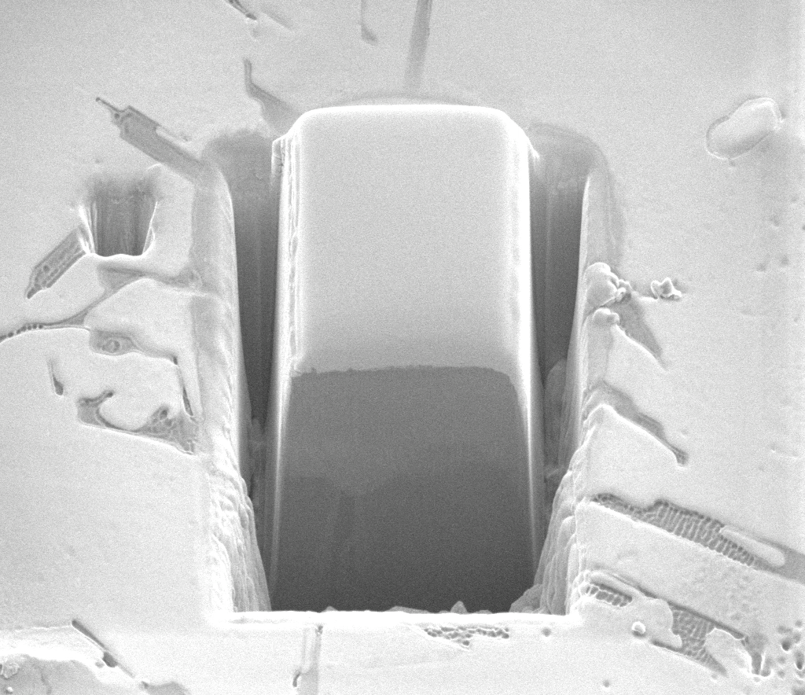
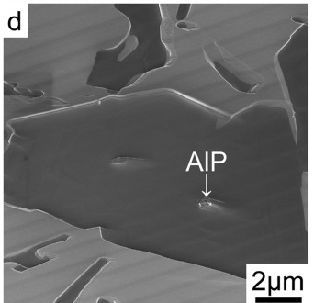
Primary Si
Serial Sectioning to Reveal Potential Nucleus
Al-18Si
J. Li et. al Nat. Sci. R. 2016
Collaboration with Dr. A. Zang
Xu, et al J. Crys. Gr. 2006

Slide 16
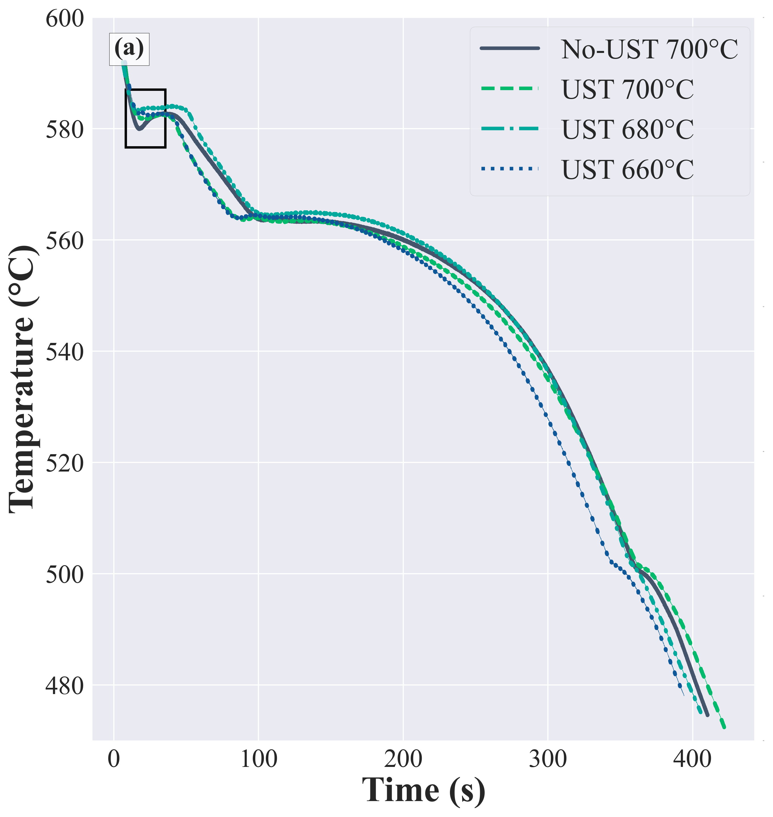
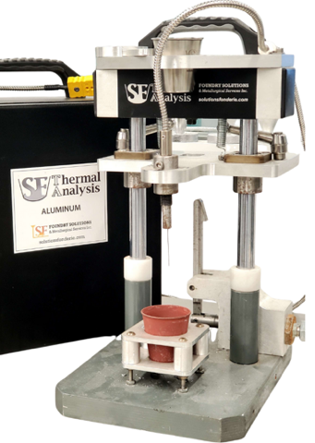
Thermal Analysis
Primary Al
⍺-Al₁₅(Fe, Mn)₃Si₂
Untreated A380
Eutectic Si
Al₂Cu

Slide 17
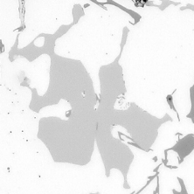
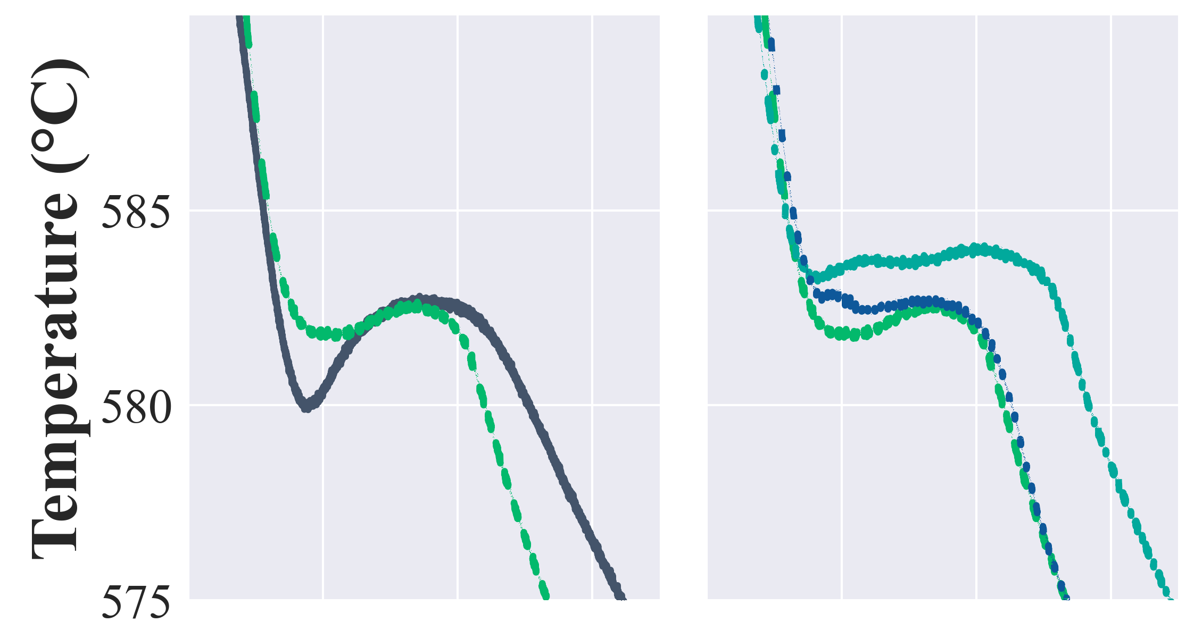
Thermal Analysis
Primary Al
⍺-Al₁₅(Fe, Mn)₃Si₂
No-UST 700°C
UST 700°C
UST 700°C
UST 680°C
UST 660°C
Primary Si undetectable during
early stages of solidification
Indicators of Primary Solidification:
Nucleation Pathway
‘Survives Remelting’
Eutectic Si
Primary
Al
⍺-script
Undercooling
Reduction in undercooling
Al₂Cu
Polyhedral Fe seen in samples with 2 peaks

Slide 18
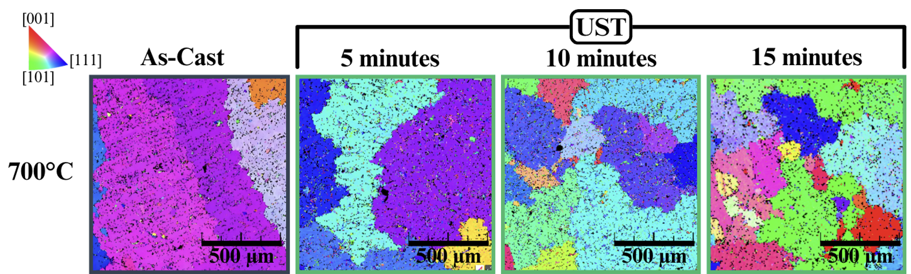
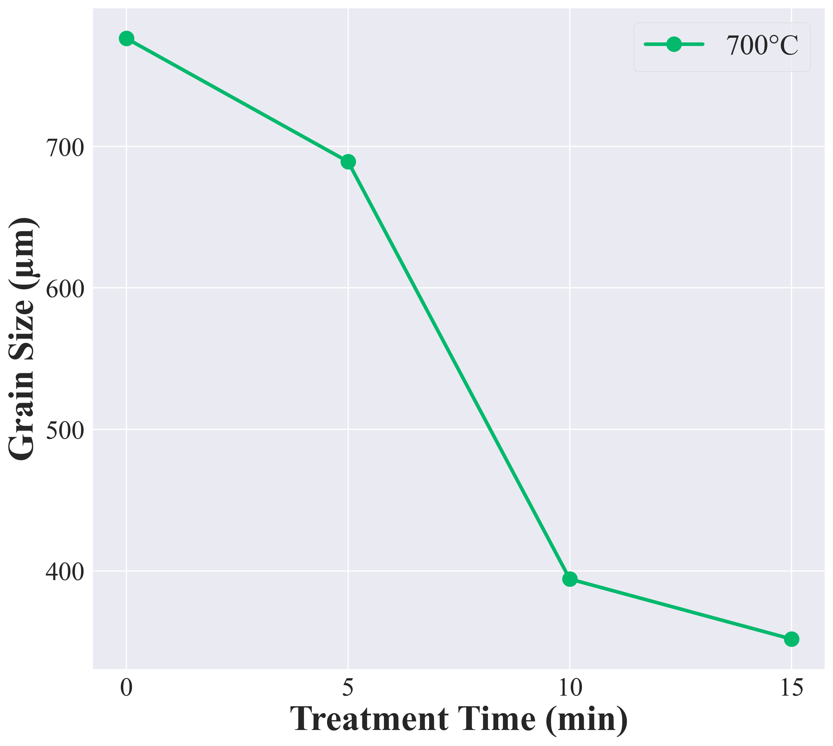
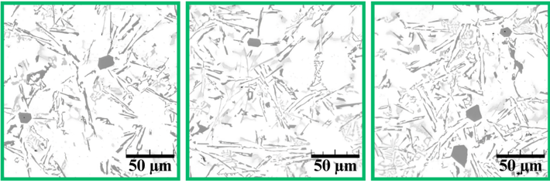
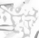
Grain Size: Treatment Time
Treatment Time
700°C
Grain Size ↓ with ↑ UST Time
Average Grain Size (µm)
OM EBSD
Expected for Refinement via Oxides
As-Cast
5
10
15
⍺-AlFeSi
After Al
β-AlFeSi
After Al
⍺-AlFeSi
After Al
Treatment Time (min)

Slide 19
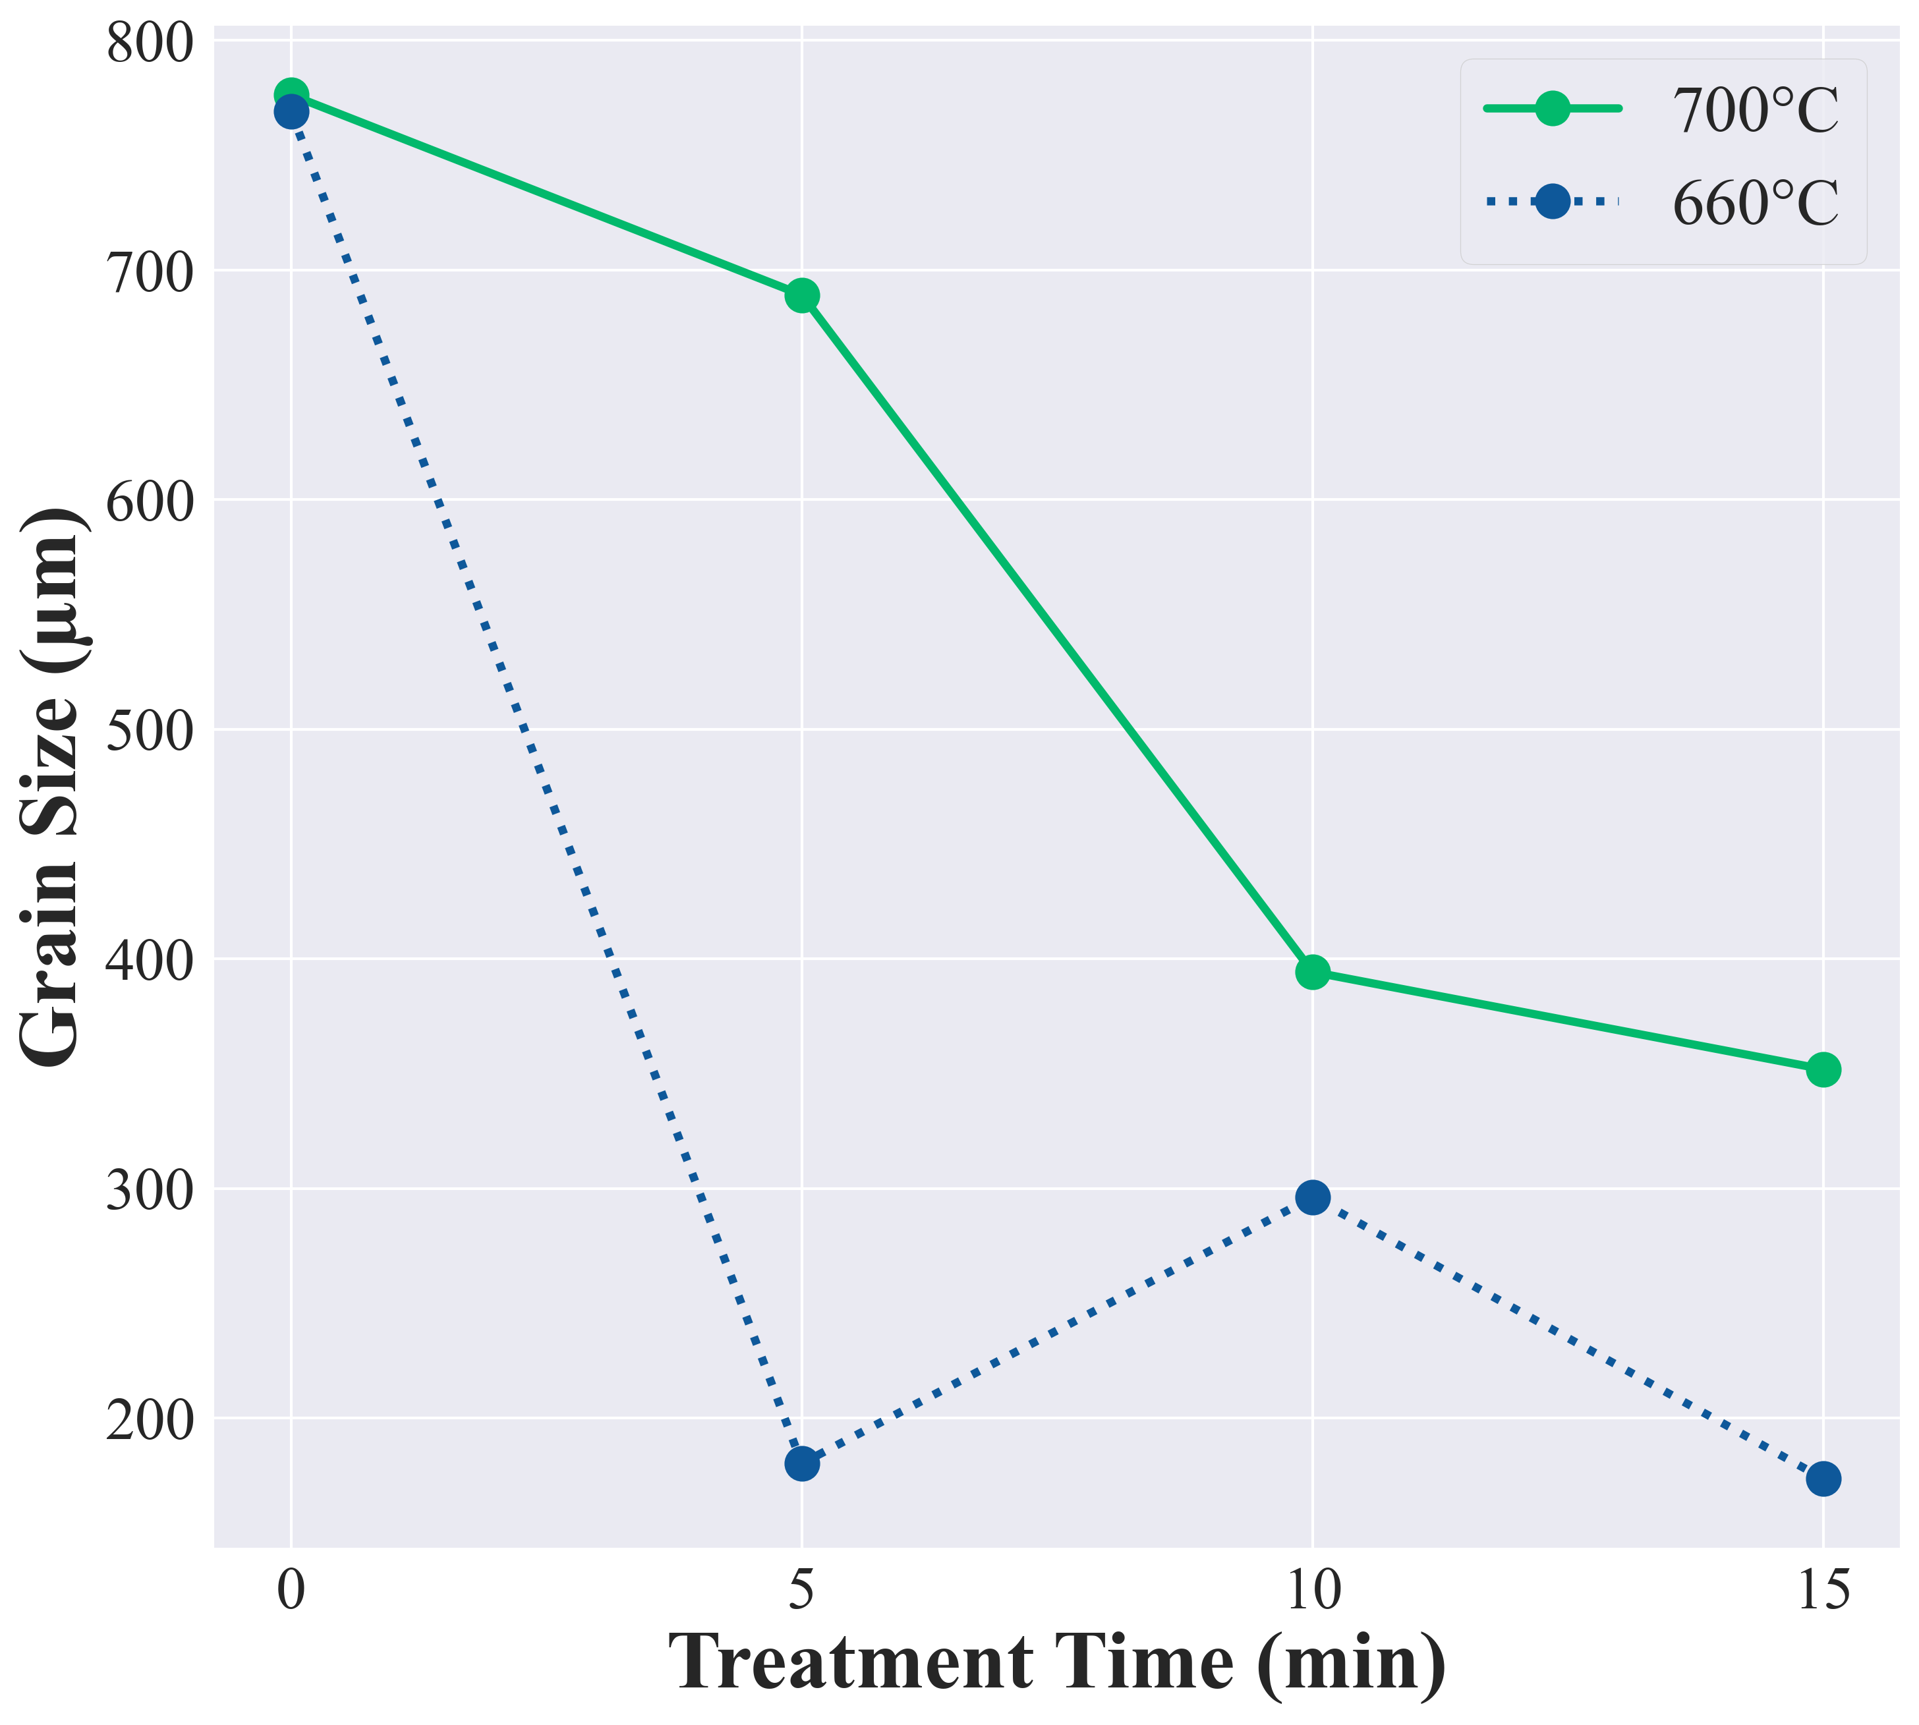
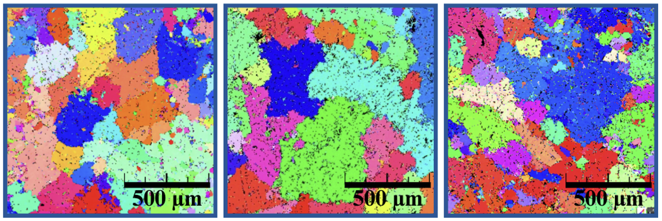
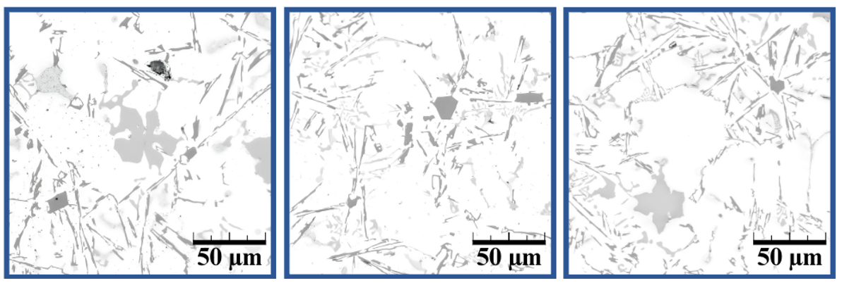

Grain Size: Treatment Time
Treatment Time
660°C
EBSD
Intermetallic Morphology influences
Grain Refinement
Average Grain Size (µm)
Grain Size Oscillates with Fe-Phase Morphology
OM
As-Cast
5
10
15
Polyhedral-Fe
Before Al
β-AlFeSi
After Al
Polyhedral-Fe
Before Al
Treatment Time (min)

Slide 20
Outline
Ultrasonic Treatment (UST) for Al Recycling
Liquid-State Multifrequency UST
Results
Conclusions

Slide 21
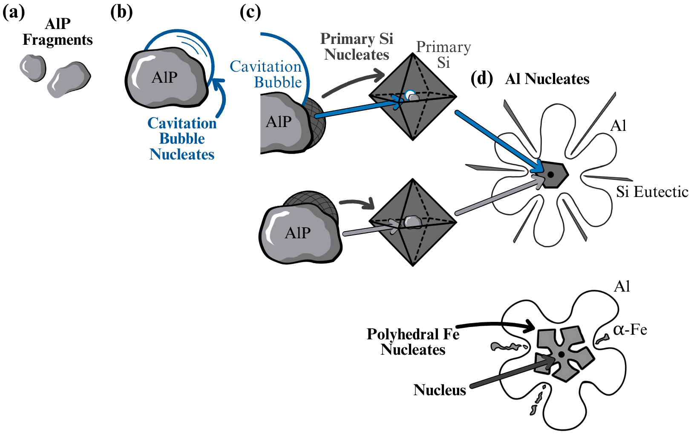
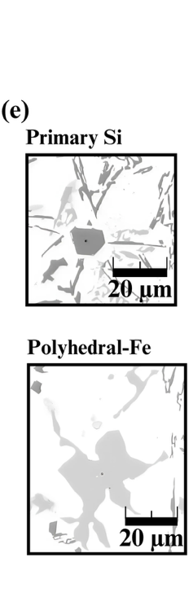
Conclusions
In Addition to Refinement via Oxides:
UST alters Solidification Chronology
Chronology influences Morphology
Morphology influences Grain Refinement

Slide 22

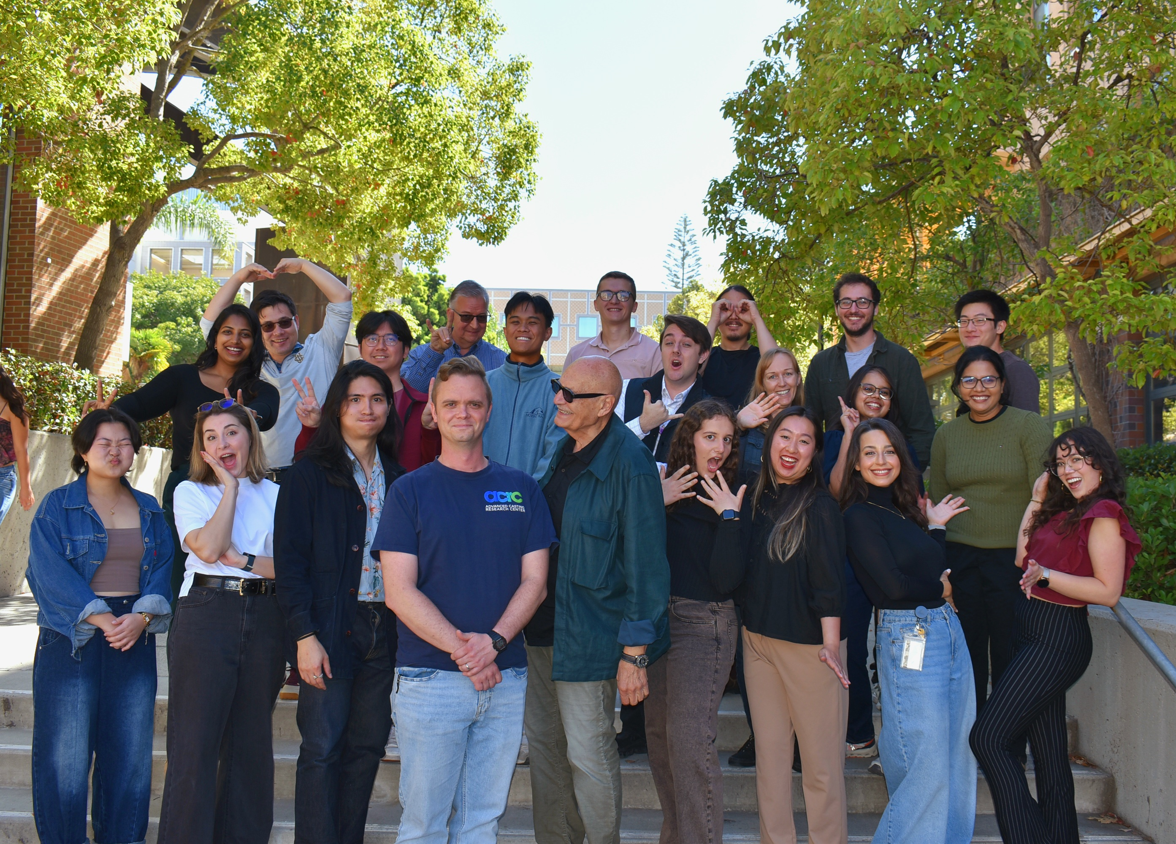
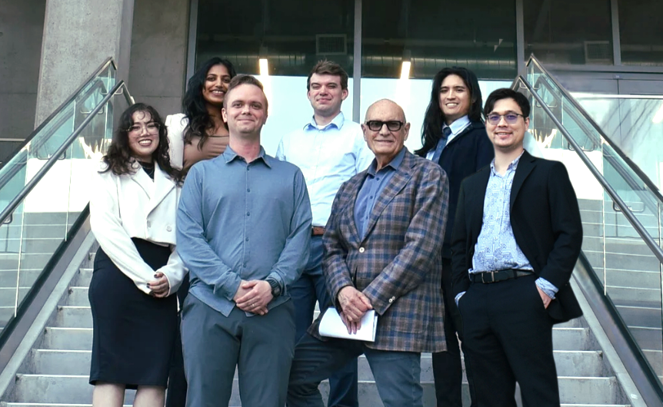








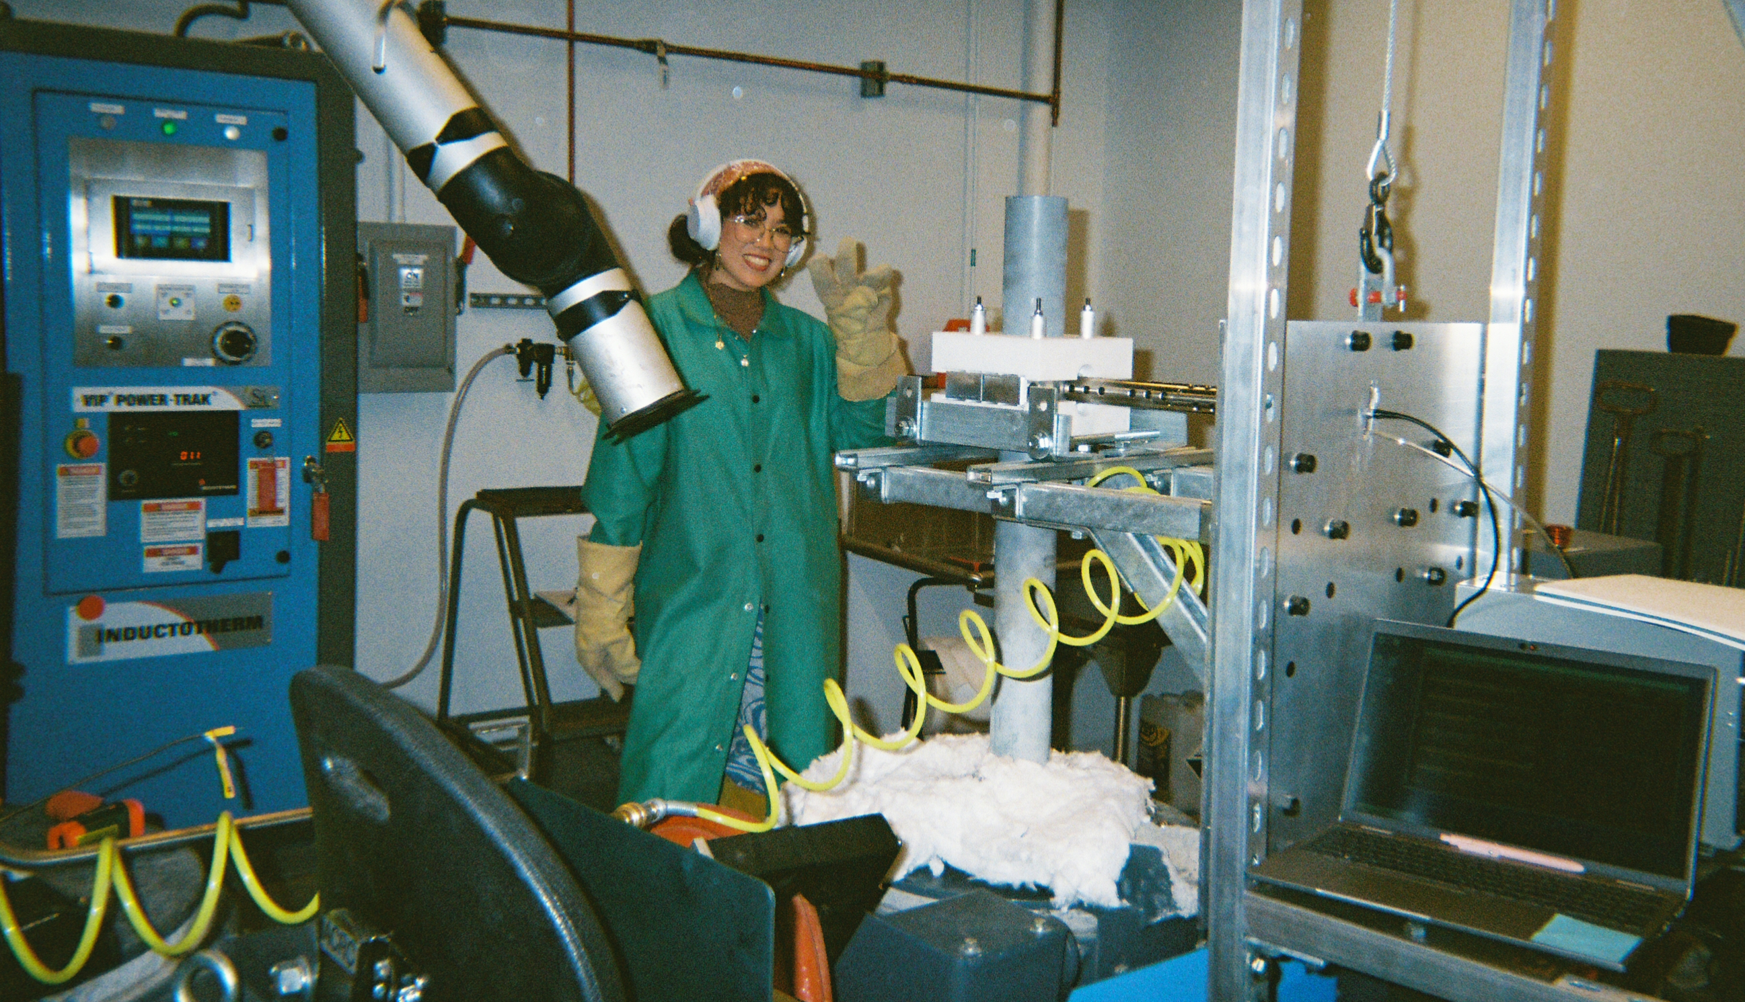




Acknowledgements
Thank you!
Contact:
Raquel Fierro Jaime
rfjaime@uci.edu
Special Thanks to Prof. Hélder Puga, Dr. Andrew Zang, and Adrianne Chang

Slide 23



About the Presenter
Raquel Fierro Jaime
Doctoral Candidate
Advanced Casting Research Center
University of California, Irvine
Highest Degree
M.S. Materials Science & Engineering 2025
University of California, Irvine
Undergraduate Degree
B.S. Materials Science & Engineering 2022
University of California, Riverside
Research Interests
Metallurgy, Metal Casting, Aluminum, Sustainability,
High Entropy Alloys, Material Processing, Solidification
Questions? ➞ rfjaime@uci.edu
Notes:
Enter speaker notes here.

